Slide 1
Intel College Excellence Program
Analytics, AI & HPC
Creating Actionable Intelligence from Data

Slide 2
Agenda-Day1
Introduction to HPC
Intel HPC Products and Software
Introduction to oneAPI and its Tools
Intel DevCloud for oneAPI
How to run code on different accelerators
Intel Modin
Intel Extension for Scikit-Learn
ANN -Artificial Neural Network

Slide 3
HPC
High performance computing (HPC) is a class of applications and workloads that solve computationally intensive tasks.
Demand is growing for HPC to drive data-rich and AI-enabled use cases in academic and industrial settings.
HPC clusters are built on high-performance processors with high-speed memory and storage, and other advanced components.
With solutions specifically tuned for high performance computing (HPC), researchers and engineers can make transformational discoveries and build innovative processes, systems, and products. Within a single system or across multiple systems, on-premises, or augmented with the cloud, HPC is more accessible than ever before.

Slide 4
Why HPC
High performance computing (HPC) is not new. HPC workstations and supercomputers have played an integral role in academic research for decades, solving complex problems and spurring discoveries and innovations.
In recent years, the quantity of data has proliferated rapidly, and many new applications benefit from the power of HPC—that is, the ability to perform computationally intensive operations across shared resources—to achieve results in less time and at a lower cost compared to traditional computing. At the same time, HPC hardware and software have become more attainable and widespread.
Scientists, engineers, and researchers rely on HPC for a range of use cases, including weather forecasting, oil and gas exploration, physics, quantum mechanics, and other areas in academic research and commercial applications.

Slide 5
How does HPC
While HPC can be run on a single node, its real power comes from connecting multiple HPC nodes into a cluster or supercomputer with parallel data processing capabilities. HPC clusters can compute extreme-scale simulations, AI inferencing, and data analyses that may not be feasible on a single system.
Some of the first and most prominent supercomputers were developed by Cray and IBM, which are now Intel® Data Center Builders partners. Modern supercomputers are large-scale HPC clusters made up of CPUs, accelerators, high-performance communication fabric, and sophisticated memory and storage, all working together across nodes to prevent bottlenecks and deliver the best performance.

Slide 6
Scaling Up Performance
HPC applications take advantage of hardware and software architectures that spread computation across resources, typically on a single server. Parallel processing within a single system can offer powerful performance gains, but applications can scale up only within the limits of that system’s capabilities.

Slide 7
Scaling Out Performance
When multiple systems are configured to act as one, the resulting HPC clusters enable applications to scale out performance by spreading computation across more nodes in parallel.

Slide 8
Benefits of HPC
HPC is gaining acceptance in academia and in the enterprise as demand grows to handle massive data sets and advanced applications. And with the advent of highly scalable, high-performance processors and high-speed, high-capacity memory, storage, and networking, HPC technologies have become more accessible. Scientists and engineers can run HPC workloads on their on-premises infrastructure, or they can scale up and out with cloud-based resources that do not require large capital outlays.

Slide 9
HPC and Intel
Intel delivers a comprehensive technology portfolio to help developers unlock the full potential of high performance computing.
Intel® hardware provides a solid foundation for agile, scalable HPC solutions. Intel also offers an array of software and developer tools to support performance optimizations that take advantage of Intel® processors, accelerators, and other powerful components.
With this broad range of products and technologies, Intel delivers a standards-based approach for many common HPC workloads through the Intel® HPC Platform Specification.

Slide 10
HPC Processors and Accelerators
Intel’s array of HPC processors and accelerators, including Intel® Xeon® Scalable processors and FPGAs, support HPC workloads in configurations from workstations to supercomputers.

Slide 11
HPC Processors and Accelerators
Intel’s array of HPC processors and accelerators, including Intel® Xeon® Scalable processors and FPGAs, support HPC workloads in configurations from workstations to supercomputers.

Slide 12
HPC Storage and Memory
The evolution of HPC storage and memory requirements has driven the need for latency reduction. Intel® HPC storage and memory solutions are optimized for non-volatile memory (NVM) technologies, HPC software ecosystems, and other HPC architecture components.

Slide 13
HPC and AI
The combined power of HPC and machine and deep learning shows amazing promise across a variety of applications, from linguistics to genomics sequencing to global climate modeling. Intel is powering HPC and AI by working with ecosystem partners to develop reference architectures and solutions designed specifically for these important solutions.

Slide 14
Intel Supports Powerful, Scalable HPC
High performance computing offers tremendous potential to researchers, developers, and engineers in academia, government, and industry.
The latest advances in computing and software continue to enable new achievements for HPC. However, it can be a challenge to choose the optimal hardware and software configurations that deliver powerful, scalable HPC solutions.
Intel continues to work closely with HPC solution providers to optimize hardware performance and blend HPC and AI with analytics. The power of HPC on Intel® architecture can spur innovation and solve increasingly complex problems, paving the way for a future of exascale and zettascale computing.

Slide 15
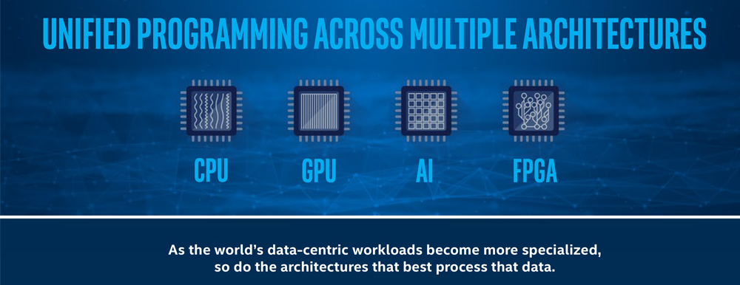
What is oneAPI?

Slide 16
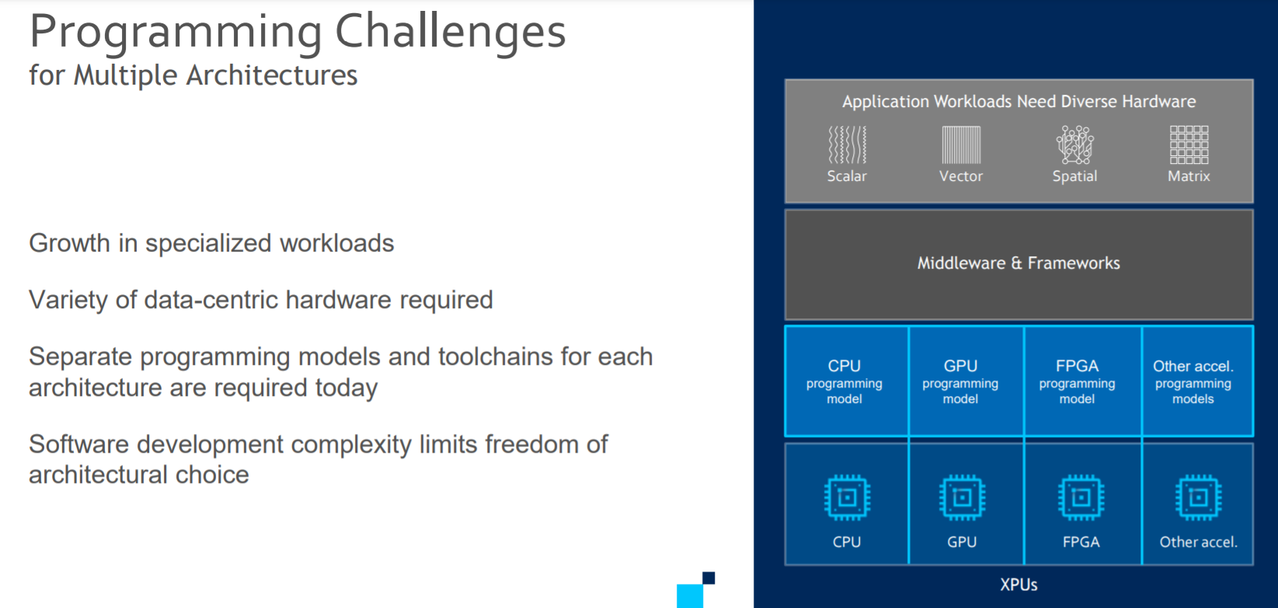

Slide 17
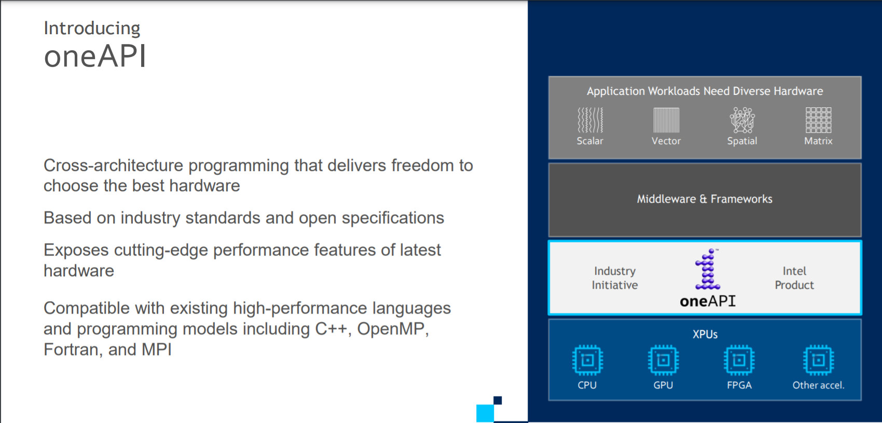

Slide 18
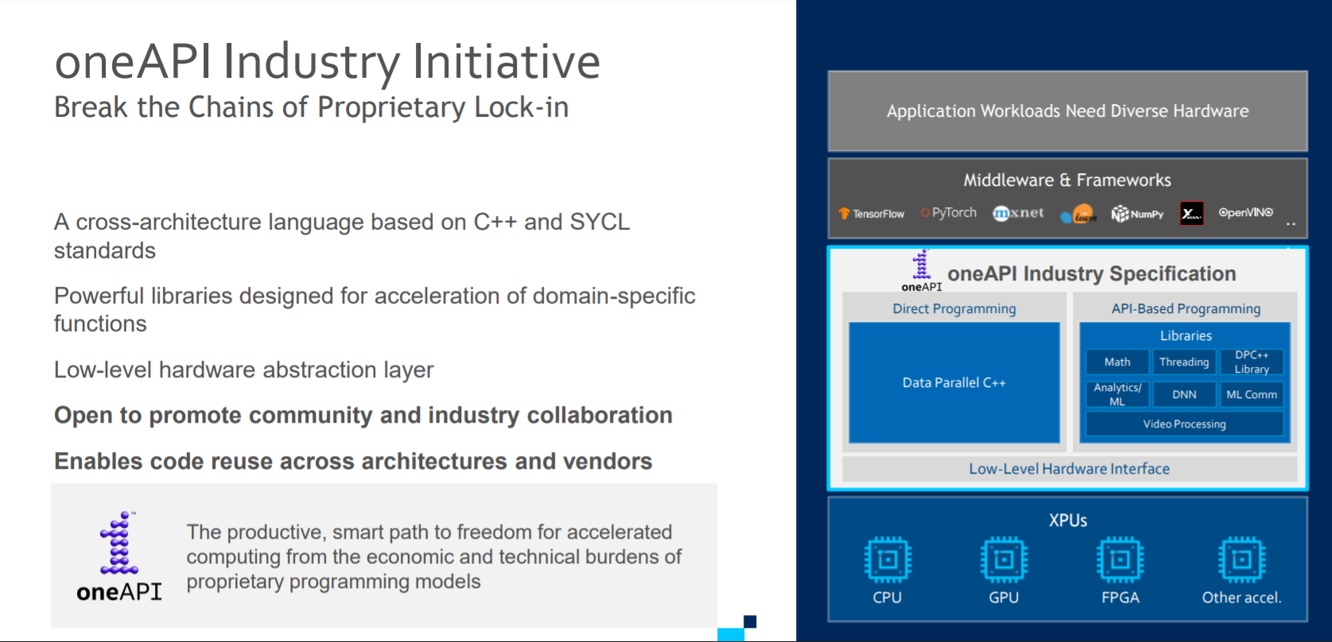

Slide 19
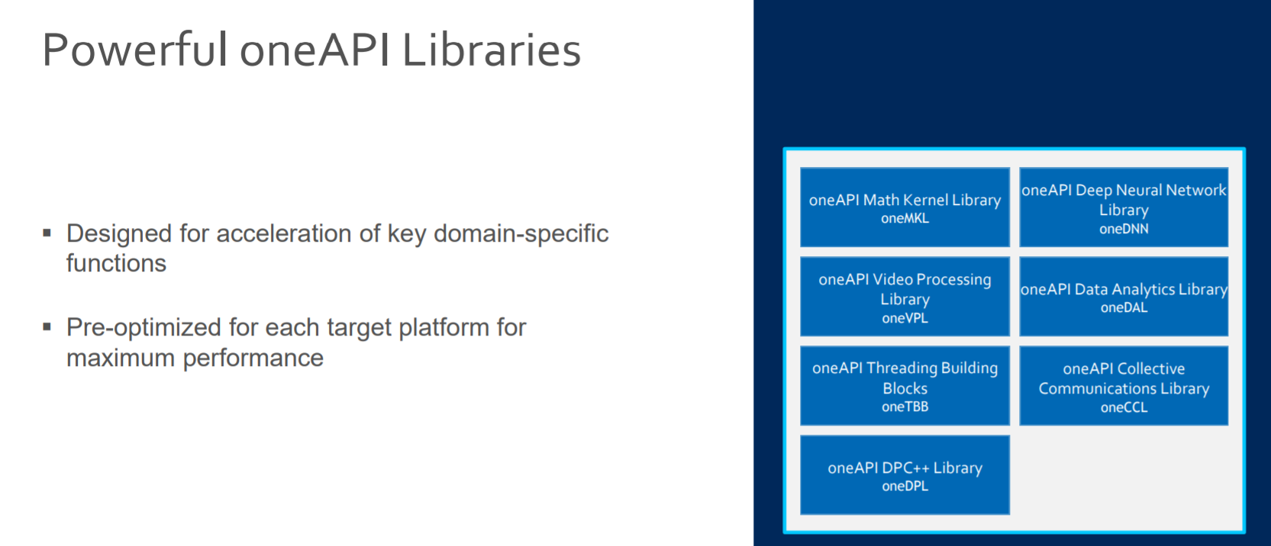

Slide 20
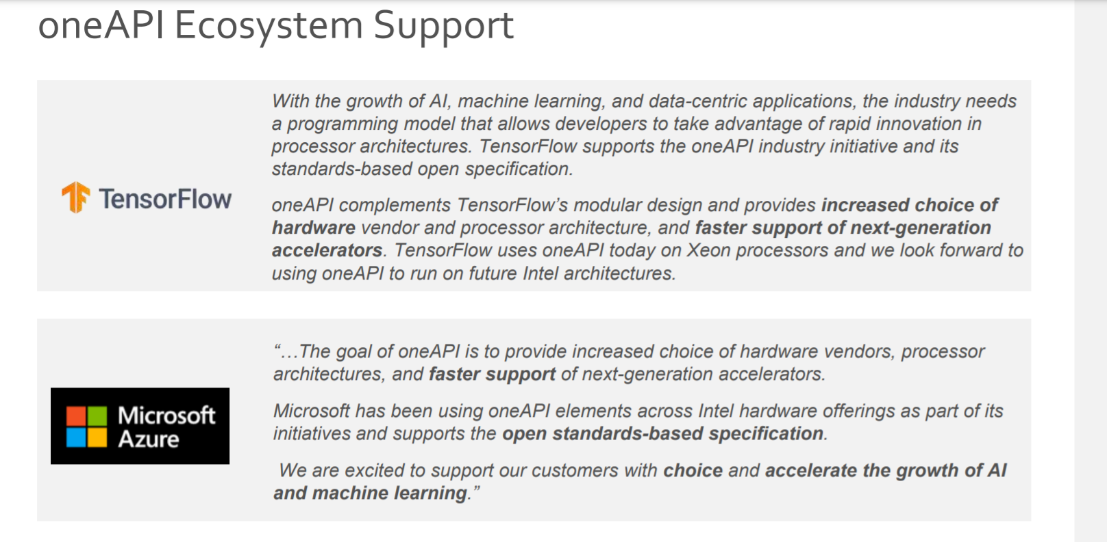

Slide 21
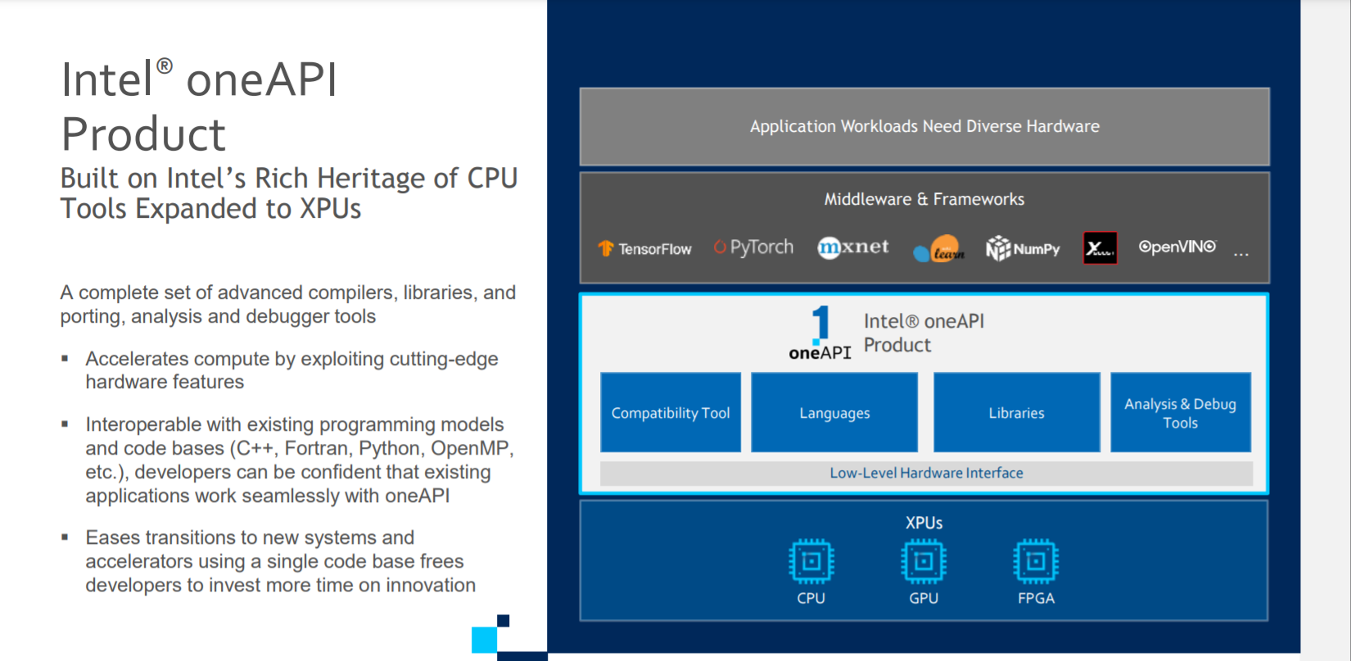

Slide 22
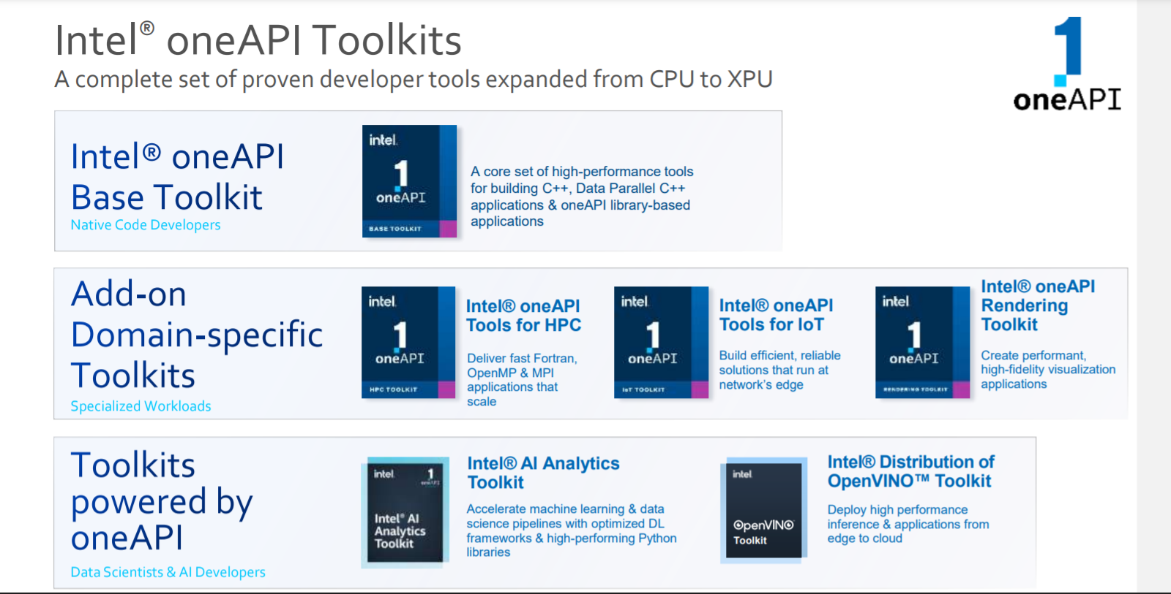

Slide 23
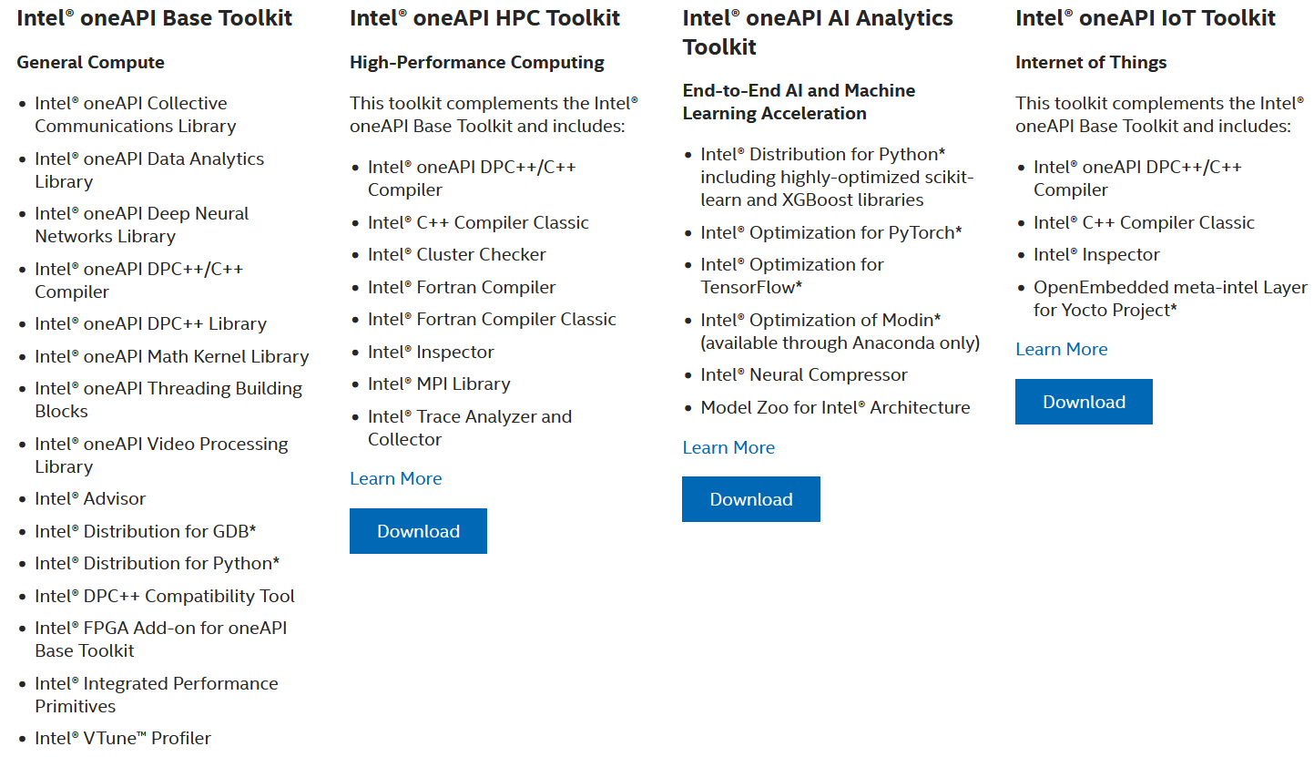
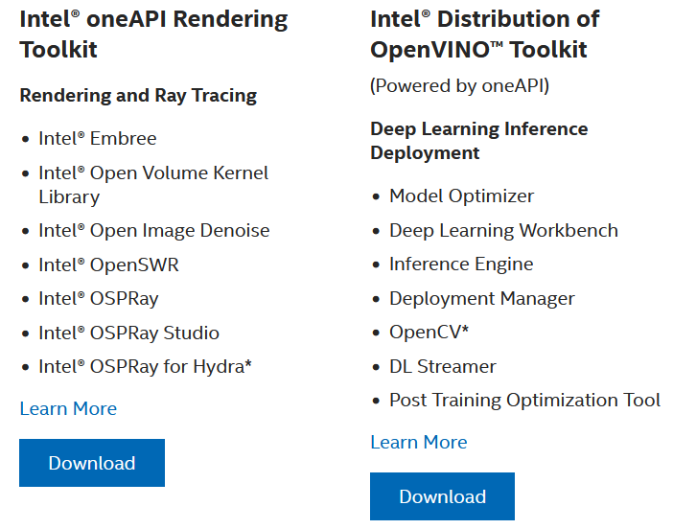
Intel OneAPI Toolkits
These toolkits are for performance-driven applications—HPC, IoT, advanced rendering, deep learning frameworks, and more—that are written in DPC++, C++, C, and Fortran languages.
Notes:
Intel Parallel Studio XE is a software development product developed by Intel that facilitates native code development on Windows, macOS and Linuxin C++ and Fortran for parallel computing.^{[2]} Parallel programming enables software programs to take advantage of multi-core processors from Intel and other processor vendors.
Intel Vtune amplifier- Stop guessing why software is slow. Advanced sampling and profiling techniques quickly analyze your code, isolate issues, and deliver insights for optimizing performance on modern processors.
Intel inspector- Locate and debug threading, memory, and persistent memory errors in applications early in the design cycle to avoid costly errors later.
Intel Advisor- Design and optimize high-performing code for modern computer architectures. Effectively use more cores, vectorization, and heterogeneous processing.

Slide 24
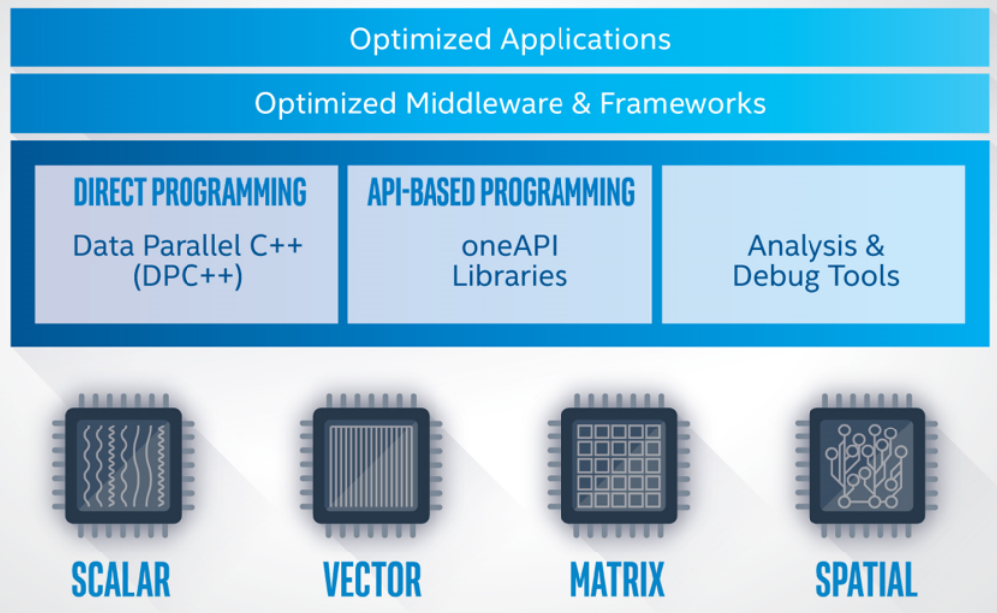
Intel OneAPI - Cross Architecture Performance
oneAPI is a cross-industry, open, standards-based unified programming model that delivers a common developer experience across accelerator architectures—for faster application performance, more productivity, and greater innovation.
The oneAPI industry initiative encourages collaboration on the oneAPI specification and compatible oneAPI implementations across the ecosystem.
Short Video Link
https://software.intel.com/content/www/us/en/develop/tools/oneapi.html#gs.36k4jr
Notes:
Intel Parallel Studio XE is a software development product developed by Intel that facilitates native code development on Windows, macOS and Linuxin C++ and Fortran for parallel computing.^{[2]} Parallel programming enables software programs to take advantage of multi-core processors from Intel and other processor vendors.
Intel Vtune amplifier- Stop guessing why software is slow. Advanced sampling and profiling techniques quickly analyze your code, isolate issues, and deliver insights for optimizing performance on modern processors.
Intel inspector- Locate and debug threading, memory, and persistent memory errors in applications early in the design cycle to avoid costly errors later.
Intel Advisor- Design and optimize high-performing code for modern computer architectures. Effectively use more cores, vectorization, and heterogeneous processing.

Slide 25
DPC++
oneAPI’s core language for programming accelerators and multiprocessors. DPC++ allows developers to reuse code across hardware targets (CPUs and accelerators such as GPUs and FPGAs) and tune for a specific architecture

Slide 26
OneDPL
A companion to the DPC++ Compiler for programming oneAPI devices with APIs from C++ standard library, Parallel STL, and extensions.
The oneAPI DPC++ Library (oneDPL) provides the functionality specified in the C++ standard, with extensions to support data parallelism and offloading to devices, and with extensions to simplify its usage for implementing data parallel algorithms.

Slide 27
OneDNN
High-performance implementations of primitives for deep learning frameworks
-oneAPI Deep Neural Network Library (oneDNN) is a performance library containing building blocks for for deep learning applications and frameworks. oneDNN supports:
CNN primitives (Convolutions, Inner product, Pooling, etc.)
RNN primitives (LSTM, Vanilla, RNN, GRU)
Normalizations (LRN, Batch, Layer)
Elementwise operations (ReLU, Tanh, ELU, Abs, etc.)
Softmax, Sum, Concat, Shuffle
Reorders from/to optimized data layouts
8-bit integer, 16-, 32-bit, and bfloat16 floating point data types

Slide 28
OneCCL
Communication primitives for scaling deep learning frameworks across multiple devices.
The oneAPI Collective Communications Library (oneCCL) provides primitives for the communication patterns that occur in deep learning applications. oneCCL supports both scale-up for platforms with multiple oneAPI devices and scale-out for clusters with multiple compute nodes.

Slide 29
Level Zero
A system interface for oneAPI languages and libraries

Slide 30
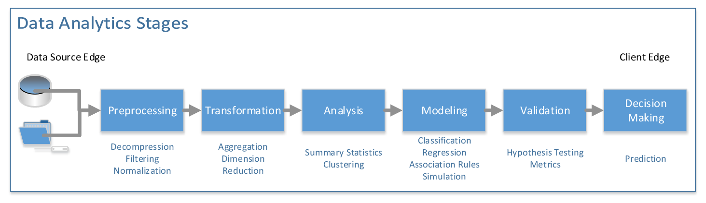
OneDAL
Algorithms for accelerated data science
oneDAL is a library that helps speed up big data analysis by providing highly optimized algorithmic building blocks for all stages of data analytics (preprocessing, transformation, analysis, modeling, validation, and decision making) in batch, online, and distributed processing modes of computation.

Slide 31
OneTBB
A library for adding thread-based parallelism to complex applications on multiprocessors.
oneTBB is a programming model for scalable parallel programming using standard ISO C++ code. A program uses oneTBB to specify logical parallelism in algorithms, while a oneTBB implementation maps that parallelism onto execution threads.

Slide 32
OneVPL
The oneAPI Video Processing Library (oneVPL) is a programming interface for video decoding, encoding, and processing to build portable media pipelines on CPUs, GPUs, and other accelerators. It provides device discovery and selection in media centric and video analytics workloads and API primitives for zero-copy buffer sharing. oneVPL is backwards and cross-architecture compatible to ensure optimal execution on current and next generation hardware without source code changes.

Slide 33
OneMKL
High-performance math routines for science, engineering, and financial applications
The oneAPI Math Kernel Library (oneMKL) defines a set of fundamental mathematical routines for use in high-performance computing and other applications. As part of oneAPI, oneMKL is designed to allow execution on a wide variety of computational devices: CPUs, GPUs, FPGAs, and other accelerators. The functionality is subdivided into several domains: dense linear algebra, sparse linear algebra, discrete Fourier transforms, random number generators and vector math.

Slide 34
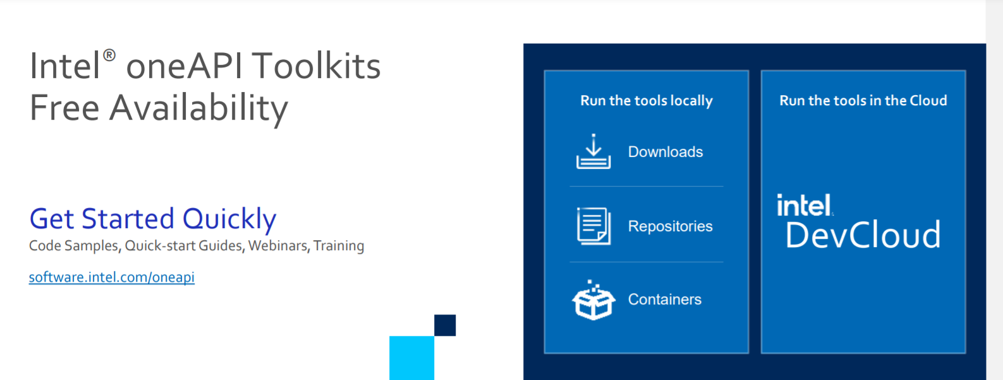
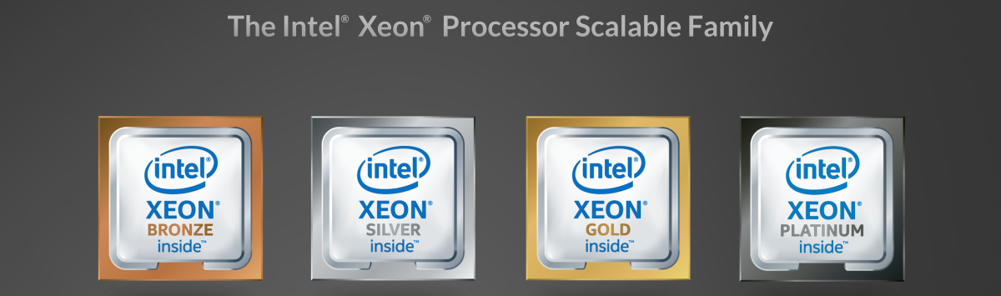
What is Intel Dev Cloud ?

Slide 35
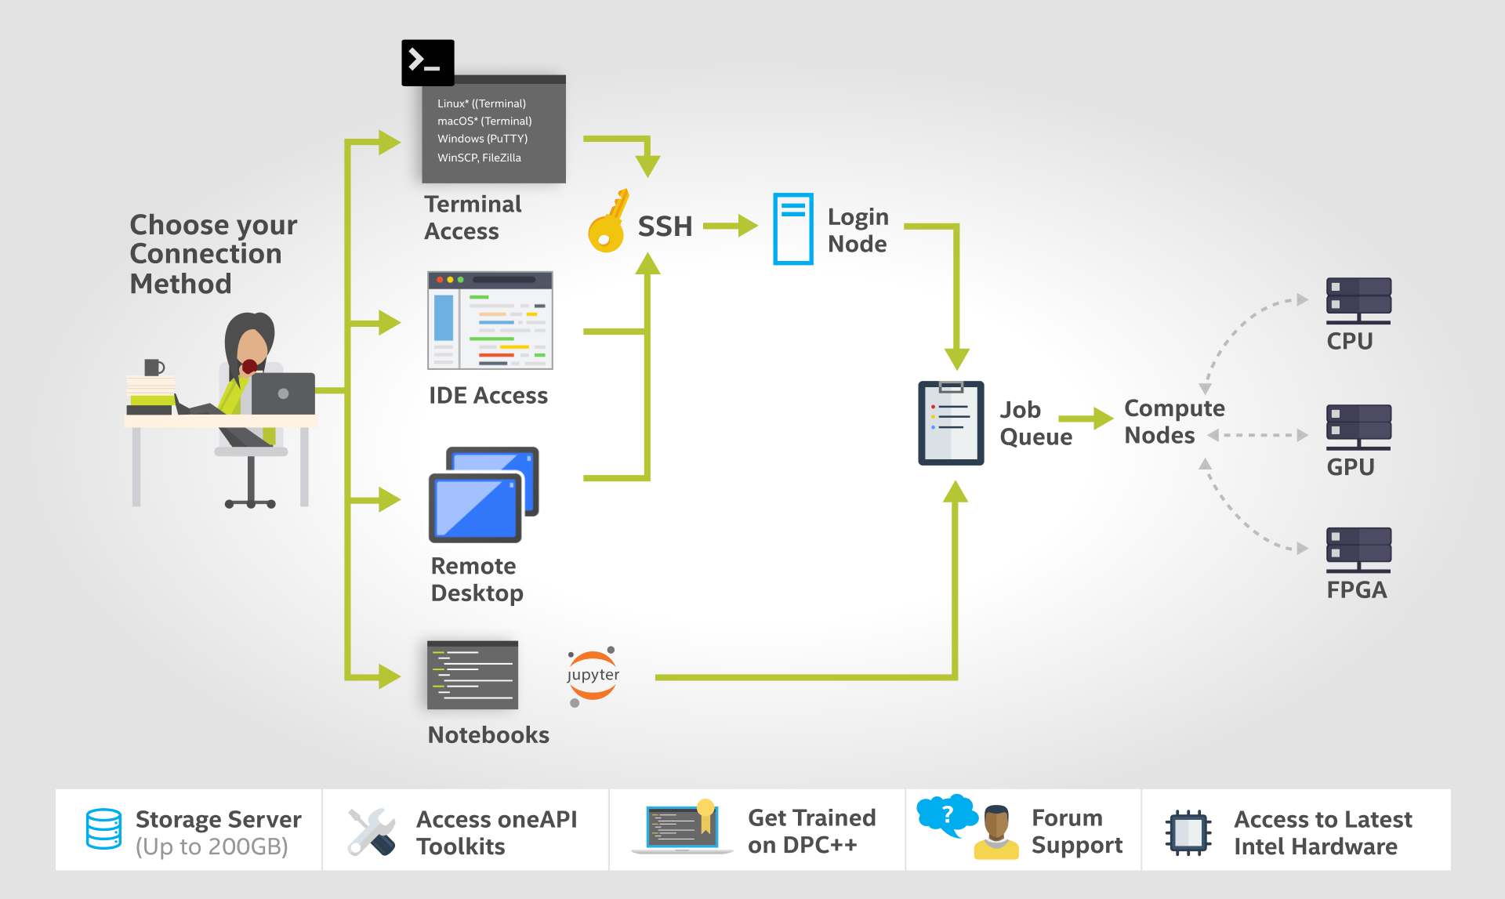
How DevCloud works?

Slide 36
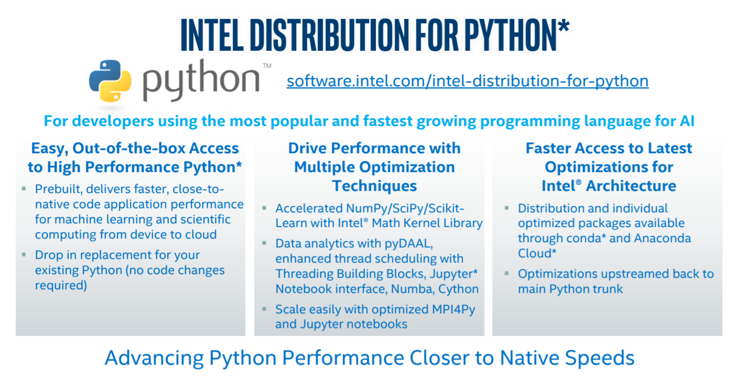

Slide 37
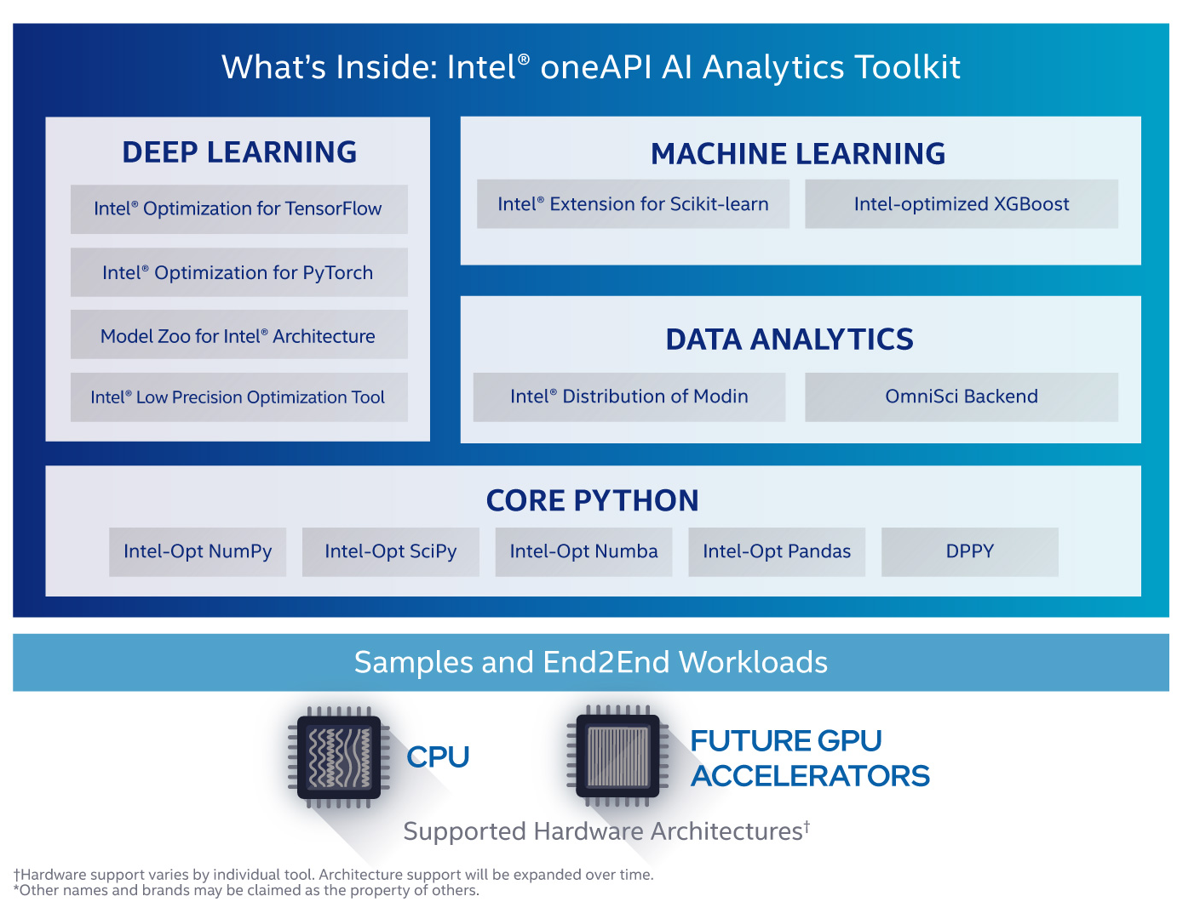

Slide 38
What software are required for this workshop?
Anaconda Software on Ubuntu
Intel Distribution of Python
Intel DevCloud for OneAPI

Slide 39
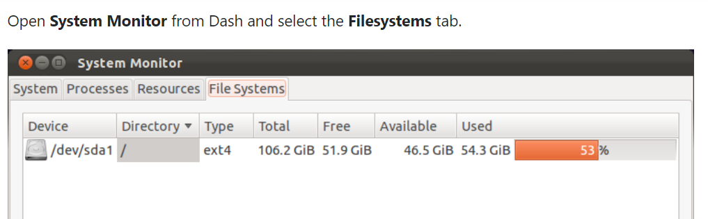
Important Ubuntu Commands
Check Ubuntu version
lsb_release –a
cat /etc/issue.net
Check Disk Space
df -h

Slide 40

Steps for downloading Intel Distribution of Python
Download Anaconda/Miniconda software
https://docs.anaconda.com/anaconda/install/linux/
Check Conda version
conda --version
Update Anaconda package
conda update conda

Slide 41
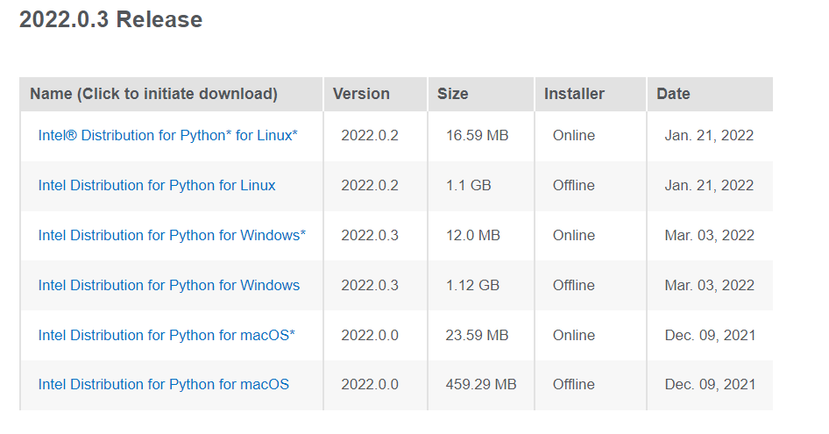
Intel Distribution of Python
https://www.intel.com/content/www/us/en/developer/articles/tool/oneapi-standalone-components.html#python

Slide 42
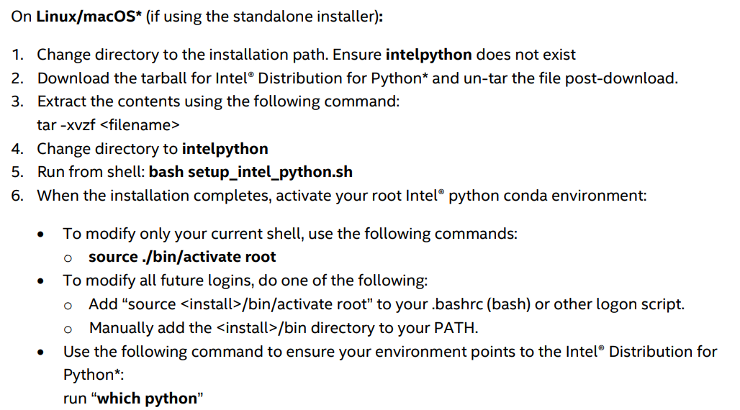
Intel Distribution of Python
https://www.intel.com/content/dam/develop/external/us/en/documents/2022_Python_Release_Notes_Intel(R)_Distribution_for_Python-Release1.pdf

Slide 43
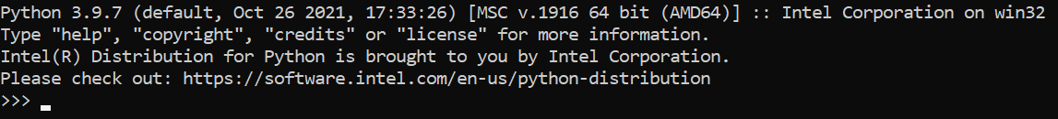
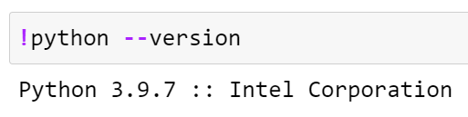
Checking if Python Intel is installed or not
On Anaconda Prompt, type python
In Jupyter Notebook, check the above statement in the code cell
Notes:
https://www.intel.com/content/www/us/en/developer/articles/tool/oneapi-standalone-components.html#python

Slide 44
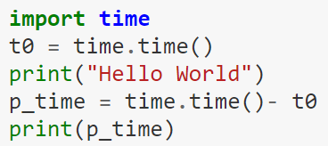
Time module in Python
%time
Use of time module from Python Standard library

Slide 45

Please contact
Foundation for Innovation and Collaborative
Education
mentor@fice.in
www.fice.in
Please contact
Foundation for Innovation and Collaborative
Education
info@fice.in
mentor@fice.in
Notes:
Here are the lessons we are going to learn today.

